Slide 1
Secondary Data
Dr Kevin McManus

Slide 2
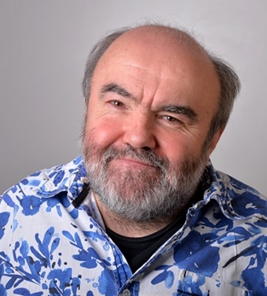
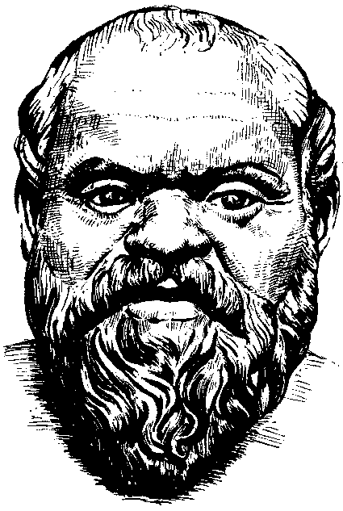
“ipse se nihil scire id unum sciat”
Socrates 470 – 399 BC
teacher of Plato
who then taught Aristotle

Slide 3
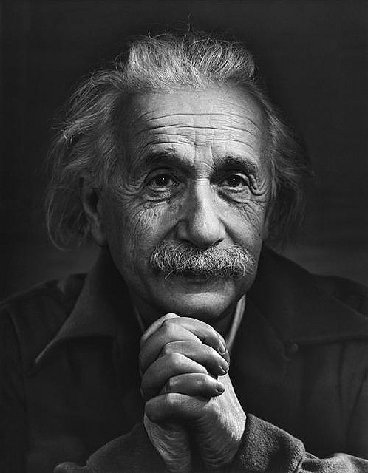
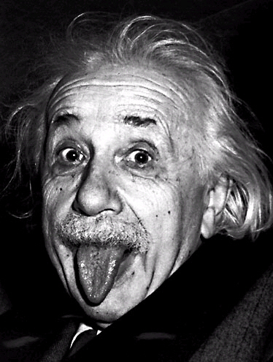
“Only two things are infinite, the universe and human stupidity, and I'm not sure about the former.”
Albert Einstein 1879 – 1955
“The more I learn, the more I realize how much I don't know”
Albert Einstein 1879 – 1955

Slide 4

“I would trade all of my technology for an afternoon with Socrates”
Steve Jobs 1955 – 2011

Slide 5

“The term may come from Greek σόφισμα (sophisma), ‘acquired skill, clever device, method’, or it might be a compound of the Greek words σοφός (sophos), ‘wise’ + μωρός (moros), ‘foolish, dull’.”
Wikipedia
image © Kingsburg High School

Slide 6
Data?
(noun) Facts and statistics collected together for reference or analysis
originates from primary research
  or metaresearch
published in primary sources
  by the people who did the research

Slide 7
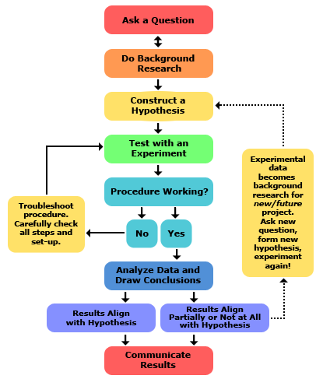
http://www.sciencebuddies.org/science-fair-projects/project_scientific_method.shtml

Slide 8
Qualitative Data | Quantitative Data
Deals with descriptions Data can be observed but not (easily) measured Sensory, personal and emotional perception of quality e.g. colour, texture, smell, attractiveness, and so on | Deals with numbers, discrete or continuous Quantity can be measured e.g. size, length, volume, capacity, rate, velocity, acceleration, sound pressure level, active members, grade point average, and so on Often represented in tabular or graphical form
Example: Freshman Class Qualitative data Friendly, positive spirit Environmentally and socially concerned Want to do well at university | Example: Freshman Class Quantitative data 309 students 126 attended library orientation tour 56% passed the maths diagnostic test
Modified from
http://regentsprep.org/regents/math/algebra/ad1/qualquant.htm

Slide 9
Primary data
Information observed or collected directly from first hand experience.
Researchers must be rigorous in designing methods to collect and publish primary data.
Secondary data
Information used in a research study that was collected by another party for a purpose other than the current investigation.
Using published data or data collected in the past.
Flanagan, C. and McGee, J. (2014) EPQ Toolkit for AQA, Illuminate Publishing

Slide 10
Primary Data Gathered from first hand experiment and experience | Primary Source Original publication from the people who gathered the primary data
Secondary Data Obtained from primary (and secondary) sources | Secondary Source A publication based on secondary data
Primary and secondary sources will often include citations (references) to other sources both primary and secondary. These lend credibility to the publication. The value of a source is often measured by the number of times it is cited.

Slide 11
Secondary Data Sources
Peer reviewed journal papers, e.g. ACM Transactions, IEEE Software, IJPHCA
Academic texts, e.g. Grady Booch, Software Engineering with Ada; Ian Sommerville, Software Engineering
Conference proceedings, often peer reviewed, e.g. SIGGRAPH
Articles in credible magazine publications, e.g. Scientific American, New Scientist, New Statesman
Standards published by authorities, e.g. ISO, BS, ANSI, W3C, IETF, OASIS
Websites published by authorities, e.g. w3.org, ietf.org, lanl.gov, gov.uk
Other online sources, e.g. top500.org, spec.org
A BBC programme made in conjunction with the Open university, e.g. Digital Technology Past and Present, Calculating Ada: The Countess of Computing
A TV documentary such as The Living Planet or Panorama
Factual (but not academic, not peer reviewed, 'coffee table') books
An article in a newspaper, e.g. The Guardian, The Telegraph, The Express
A review on a website, e.g. Tom's Hardware, PC Advisor
TED talks
A Wikipedia page
A blog from a self-appointed expert
A YouTube video
A Twitter post

Slide 12
Literature Review
A literature review is a review of literature.
Literature is stuff that has been published.
The literature review is not a compilation of facts and feelings but a coherent argument that leads into the description of the proposed study (Ruderstam and Newton 2007 page 47).
According to Rudestam and Newton (2007) a common misunderstanding is that a literature review is a 'laundry list of previous studies with sentences or paragraphs beginning with words such as Smith found that… or Jones concluded that …'.
Rudestam, K. E. and Newton, R. R. (2007) Surviving Your Dissertation: A Comprehensive Guide to Content and Process 3rd Edition, SAGE

Slide 13
Ontology is the philosophical study of the nature of being, becoming, existence, or reality, as well as the basic categories of being and their relations.
In informatics, an ontology is a formal naming and definition of the types, properties, and interrelationships of the entities that exist for a particular domain. It is thus a practical application of philosophical ontology, with a taxonomy.
Epistemology is the philosophical study of the nature and scope of knowledge, justified belief.
It questions the nature of knowledge, how it can be acquired, the extent to which knowledge pertinent to any given subject or entity can be acquired, and how this relates to connected notions such as truth, belief and justification.
Adapted from Wikipedia

Slide 14
Greenwich Graduate Attributes
Cross-cultural and International Awareness
Creativity and Enterprise
Scholarship and Autonomy
Have an informed understanding of their discipline or professional practice, and the ability to question its principles, practices and boundaries.
Think independently, analytically and creatively, and engage imaginatively with new areas of investigation.
Appreciate disciplines and forms of professional practice beyond their own, and draw connections between them.
Are intellectually curious, responsive to challenges, and demonstrate initiative and resilience.
Sophomore no more
Develop an inquiring mind, ask questions.
Question everything, especially ones own assumptions.
Be critical, do not accept everything at face value, question the validity of the data?
Always make new mistakes.
"Insanity: doing the same thing over and over again and expecting different results."
Albert Einstein 1879 – 1955

Slide 15

Questions?

